Slide 1

Bus Reservation System

Slide 2



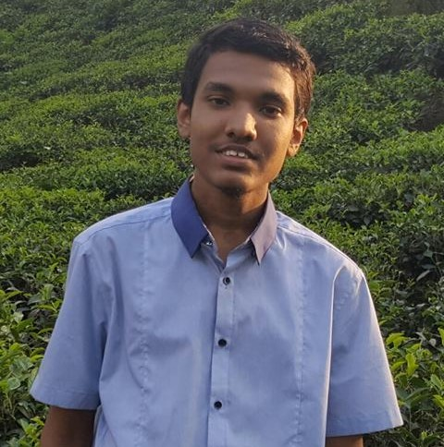
Group Members
Sadman Muhib Samyo
160041025
Group Lead
Tahmidul Islam
160041021
Dewan Tarikul Mannan
160041027
Fahim Abid Jami
160041020

Slide 3
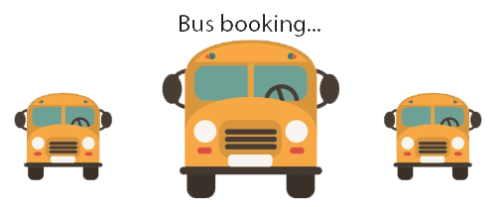
Overview
Bus Reservation System:
A reservation system of bus seat which allows customers to select bus and some specific bus seat of their choice and reserve it.

Slide 4

Features
Customer can select His/her origin & destination
Can select the date and time of journey
Can select the type of bus (AC/Non-AC)
All the bus details according to customer’s choice will be available
Can chose the bus of his/her own choice

Slide 5
Features
Can chose his/her seat and can also select multiple seats
Seats can be selected just by clicking on them
Very easy to use
A customer can not select previously selected seats
Buses and places can be added and edited

Slide 6
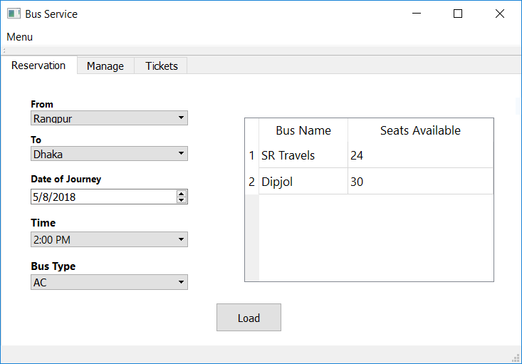
How to reserve a seat
Journey details and selecting bus
Select Origin
&
Destination
Select Date
&
Time
Select
Bus Type
Click
Load
Select Bus

Slide 7
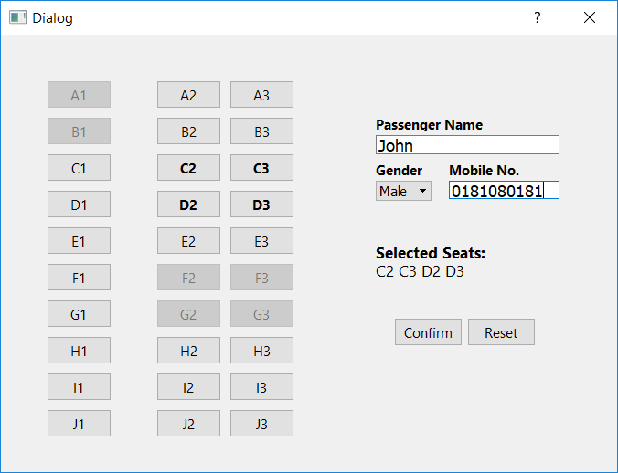
How to reserve a seat
Chose seat and Confirm
Provide Passenger name
Provide Gender &
Contact Number
Select Seats just by clicking
Click Confirm
If Everything is okay
Click Reset
For changing anything

Slide 8
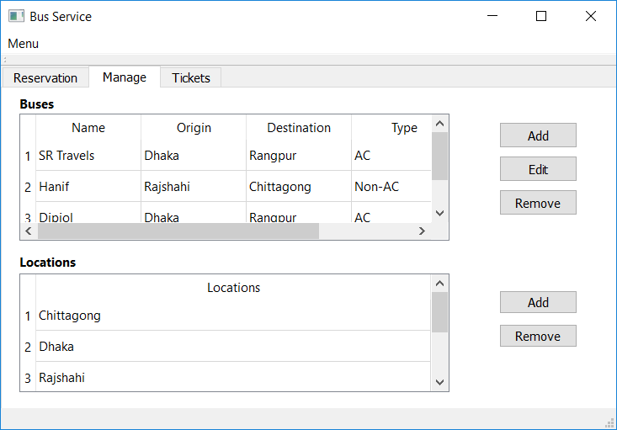
Manage Bus and location details
For adding click add
Add
New Info
For Editing click Edit
Edit
Existing Info
For removing click remove

Slide 9
What we have used?
C++: For program logic and functionality implementations
Qt 4.5.1 : For user-interface programming
SQLite: For storing and manipulating bus related data

Slide 10


